Slide 1
Maverick Advanced Technologies Implementation Council (MATIC)

Slide 2

MATIC Guiding Principles
Adopt field first philosophy
Successful change requires executive sponsorship
Educate the field & office to ensure they have the same understanding
The best way to gain trust is to demonstrate value
Spend time and effort in hands-on training to improve adoption

Slide 3


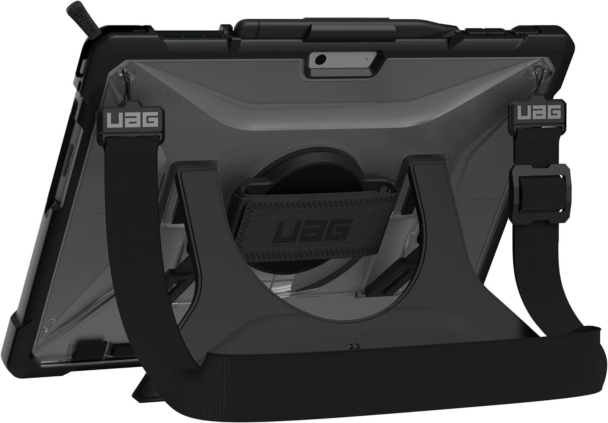

One of our most important workspaces…
One of our most important workspaces was being neglected
Not getting the IT ticketing support
Not empowered to influence corporate technology decisions
Inconsistent in feel & quality
Not designed for success
Service Desk has been partnering with Field Admins to ensure high levels of customer service for Field Personnel
Per strong field request, we are moving on from Surface Tablets (zero cost increase, long term maintenance costs will be reduced from
Infrastructure team will improve internet connectivity at the field offices (currently bottlenecked by centralized data center internet flow)
Evaluating additional options on an as-needed basis (e.g. Cell Boosters, Starlink, etc. etc.)
Same Price, Longer Lifespan… Better Form Factor for O&G Work Conditions

Slide 4

Maverick Operational Priority System (MAV OPS)
Less than 20 minutes per day doing data entry
85%+ Productive time
LOs area assigned high value tasks
End of Shift Report is automatically compiled for the field management team! No more digging in outlook, notebooks or texts to explain past production variances!
Seamless field communication historized in the data lake
Day to Day note taking is seamlessly integrated with back-office systems!
Resources Allocated to Top Issues (Field Wide)

Slide 5










KPIs to Measure PbP Success
35% of Day
85%+
Key Sources of Waste
Data Analysis
Data Entry
Opportunity Cost (going to low priority sites)
Wasted Travel
Not able to fix the issue
Re-routed mid flight
Collecting Unnecessary Information
Failing to fix / inspect things while on site
Capable people who are qualified to address issues are quickly dispatched. Their truck is loaded with the right tools and materials, they understand what is expected for the day at 6 AM. They are re-routed only if something critical comes up, which is communicated to them in an efficient manner.
Leading indicators of success
% Productive Time (Time working at Field Sites / Total Time)
Impact per Visit ($ Prod Returned + $ Inventory Sold / # visits)
Field Office vs. Productive Worker (Office Support LOE / Field Support LOE) (HRS within Office / HRS at Routes Stops)
Ultimately, Cash flow is the measure of success.
Beginning of Shift Analysis
Travel
Inspect
Fix
End of Shift Data Entry
15% of Day
20% of Day
0%
5%
Waiting on Approval
Collecting Unnecessary Information
20 minutes or less of data entry
Wasted Miles
30% of Day
Fail to Fix
Poor Inspection
<10%
7+ Productive Hours per day (8hr shift)

Slide 6
Pump by Priority - WAB

Slide 7
Labor & Vehicles Long Term Trend
Baseline
Project Economic Target (Budget)
Top Quartile Benchmark

Slide 8
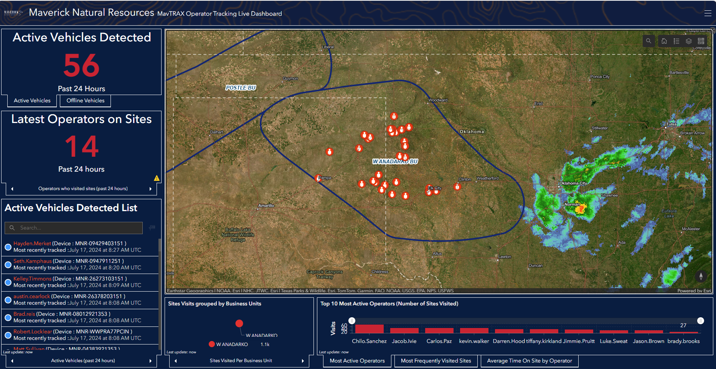
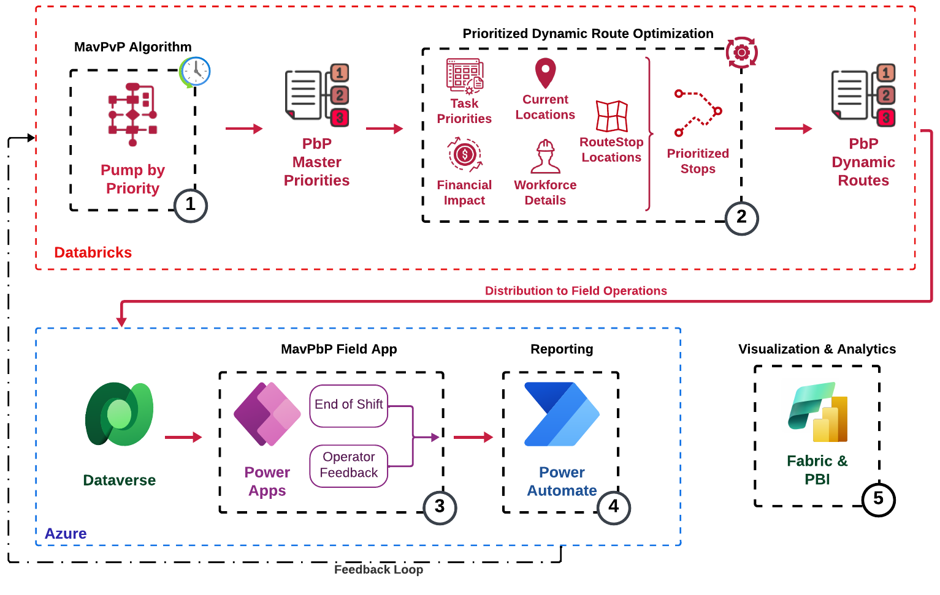
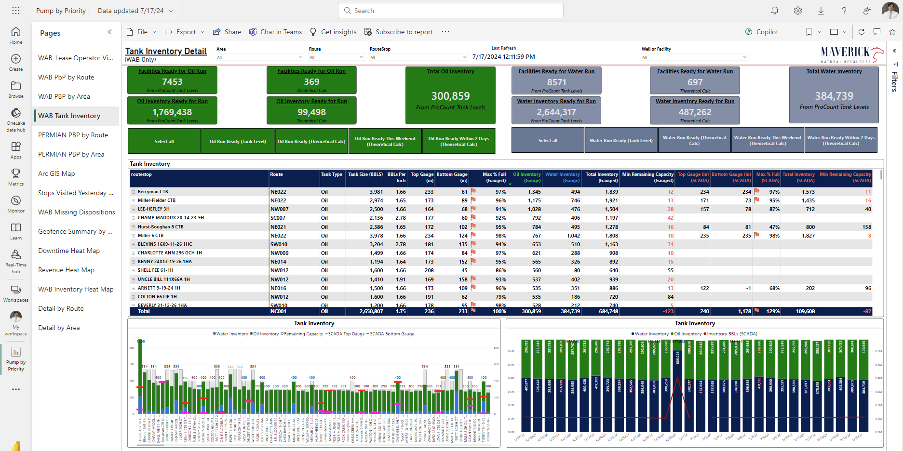
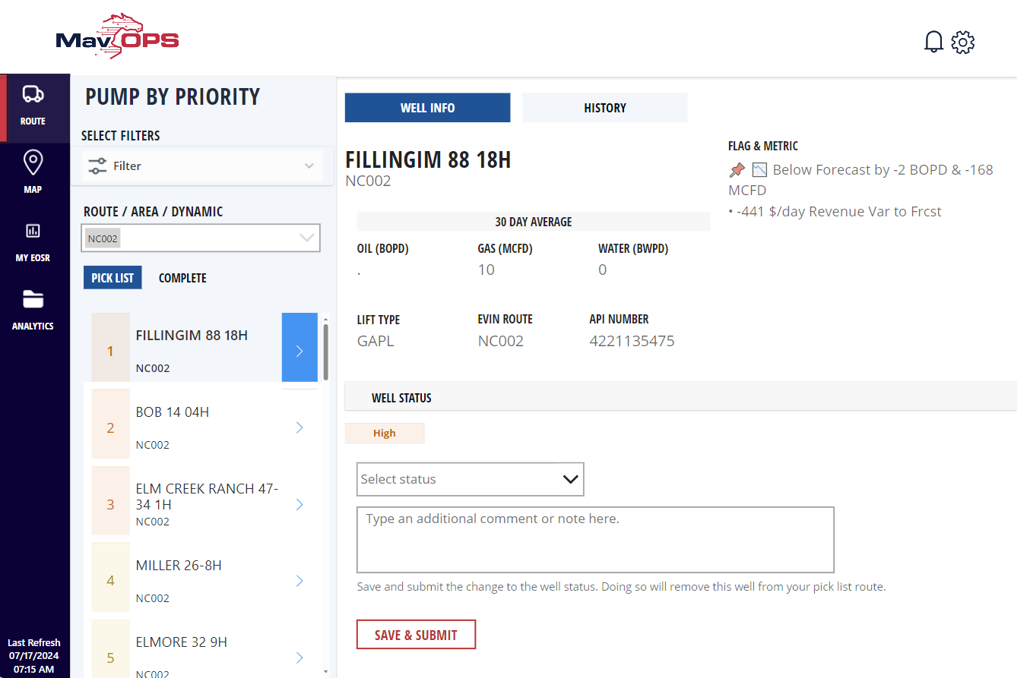
Tools & Capabilities
Empowering Efficiency: Technical Architecture
MAVTRAX Dashboard
Developed to Validate Data Flow and showcase ESRI capabilities.
Best Use Case is Tracking Personnel during severe weather events
Access Granted by Rick & Jerod Fields (Can see ALL personnel)
Consolidated ERP datasets result in improved feedback and reduced data silos. The increased production is realized by responding to real-time data analytics of a comprehensive data driven digital-twin. Our cutting-edge prioritization algorithm dynamically adapts to changing conditions, ensuring resources are optimally allocated, while automation capabilities streamline workflows, reducing manual intervention and enhancing operational agility.
MavOPS PowerBI Dashboard
Set of Dashboards that allows analysts and management personnel to take a deep dive into the MavOPS data.
MavOPS Power App
User Interface for Field Personnel (currently focused on WAB Lease Operators). Presents information in an easy to digest way and facilitates communication between LOs, their management and the Ops Center.
The win is realized by improving data delivery speed; enabling qualified operators to do meaningful work quickly.

Slide 9
MavOPS <> ULTIMO <> Wellview <> EVIN <> JOYN
MavOPS <> EVIN
EVIN Comments are pulled into MavOPS
All EVIN Data Entered is pulled into MavOPS through existing ProCount Integration (key driver)
MavOPS Comments will be able to push into EVIN
Downtime, Guaging, etc. will continue to be entered into EVIN directly
MavOPS <> WellView
WellView Comments are pulled into MavOPS
MavOPS can trigger an RCFA submittal (through SharePoint process)
RCFA and Downhole work will be managed within Wellview
Status of work & RCFA will be presented in MavOPS
MavOPS <> ULTIMO
Active ULTIMO WOs will be be shown in MavOPS
ULTIMO & MavOPS operate independently (currently do not have integration within Scope)
MavOPS <> JOYN
JOYN & MavOPS are driven off of the same Hierarchy Management Toolset
Currently JOYN & MavOPS integration is OOS.
Team plans to evaluate this during MavOPS Phase 2
JOYN is much more narrow & detailed focus to accommodate the safety workflows.

Slide 10
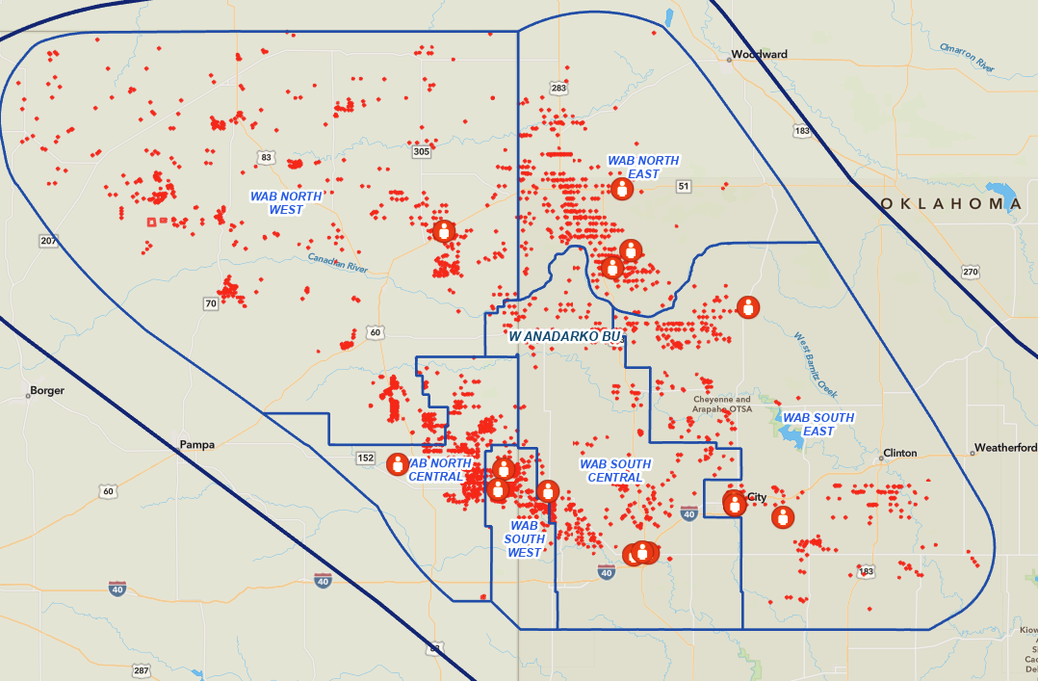
BU Level Resource Allocation
There is a discrepancy between Workload, Value and Area Boundaries
Dynamic Routes have been fully tested within Area Boundaries. But results are sub-optimal field wide.
First Pass – Have multiple scenarios for each Area (+1 Resource, - 1 Resource) Provide Health Status by Area and encourage Foreman to identify opportunities to shift resources from area to area.
Second Pass – Create Dynamic Routes using Consolidated Areas
NC, SW, SC
SE, NE
NW
Final Pass – BU Level Dynamic Routes

Slide 11
2 Levers to Optimize Margins
Route Optimization
Through Area Level Route Optimization, 8 Routes can be Eliminated
Area Consolidation
Consolidate to 2 Areas 6 Areas -> 2 Areas
Additional 5 Routes Eliminated
Target 100% Completion of Critical & High + 40% Completion of Mediums
WEST
Recommended
EAST
AREA | Flags (C/H/M) | FCF | Routes*
NE | (7,79,127) | $53MM | 8
SE | (1,16,49) | $9MM | 1
SC | (1,25,80) | $9MM | 2
EAST | (9,120,256) 385 | $71MM | 11
NW | (0,24,150) | $17MM | 3
NC | (3,21,90) | $18MM | 3
SW | (1,11,100) | $18MM | 2
WEST | (4,56,340) 400 | $53MM | 8
NORTH
Alternative Option
SOUTH
* New recommendation assuming dynamic optimization in place

Slide 12
Route Distribution
Previous Routes are based on # wells and drive time. Did not factor Cash Flow / Liquid Production
Anticipated activity was not factored in, including
Lift Equipment Troubleshooting
Gauging Frequency
Update Routes based on Cash Flow and Activity
Leverage Data to Decrease Routes from 33 to 19
Average Cash Flow per LO increases from

Slide 13
Updated Operations Org (Option #1)
Super
Admin
Production Foreman
Production Foreman
Operations Lead
Lease Operator
Lease Operator
Lease Operator
Lease Operator
Operations Lead
Operations Lead
Operations Lead
Lease Operator
Lease Operator
Lease Operator
Lease Operator
Lease Operator
Lease Operator
Lease Operator
Lease Operator
Lease Operator
Lease Operator
Lease Operator
Lease Operator
Lease Operator
Lease Operator
Lease Operator
Admin
Admin

Slide 14
Updated Operations Org (Option #2)
Super
Super
Foreman
Lease Operator
Lease Operator
Lease Operator
Lease Operator
Foreman
Foreman
Foreman
Lease Operator
Lease Operator
Lease Operator
Lease Operator
Lease Operator
Lease Operator
Lease Operator
Lease Operator
Lease Operator
Lease Operator
Lease Operator
Lease Operator
Lease Operator
Lease Operator
Lease Operator
Admin
Admin
VP Ops
Operations Lead
Operations Lead
Operations Lead
Operations Lead

